Slide 1
Computer Networks and Internets
《计算机网络与因特网》课件
林坤辉

Slide 2
PART IV Internetworking
Chapter 21 IP: Internet Protocol
addresses
I P：互联网协议地址

Slide 3

21.2 Addresses for the Virtual Internet 虚拟互联网地址
The goal of internetworking is to provide a seamless(无缝) communication system.
Internet protocol software must hide the details of physical networks and offer the facilities of a large virtual network.
An internet is merely an abstraction imagined by its designers and created entirely by software.

Slide 4
To give the appearance of a single,uniform system,all host computers must use a uniform addressing scheme,and each address must be unique.
To guarantee uniform addressing for all hosts,protocol software defines an addressing scheme that is independent of the underlying physical addresses.

Slide 5
Users, application programs, and higher layers of protocol software use the abstract protocol addresses to communication.
The designers are free to choose addresses, packet formats, and delivery techniques independent of the details of the physical hardware.

Slide 6
21.3 The IP Addressing Scheme
IP编址方案
In the TCP/IP protocol stack, addressing is specified by the Internet Protocol(IP) .
Each host is assigned a unique 32-bit number known as the host’s Internet Protocol address(or IP address).
To transmit information across a TCP/IP internet, a computer must know the IP address of the remote computer to which the information is being sent.

Slide 7
21.4 The IP Address Hierarchy
IP地址层次
Each 32-bit IP address is divided into two parts: a prefix and suffix.
The address prefix identifies the physical network to which the computer is attached.
The suffix identifies an individual computer on that network.

Slide 8
Each physical network in an internet is assigned a unique value known as a network number.
Network number assignments must be coordinated globally.
Each computer on a given physical network is assigned a unique address suffix .
suffixes can be assigned locally without global coordination.

Slide 9
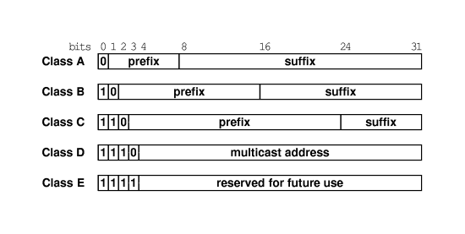
21.5 Original Classes of IP Addresses IP地址分类

Slide 10
21.6 Computing The Class of An Address 地址类别的计算
Whenever it handles a packet, IP software needs to separate the destination address into a prefix and suffix .
Classful IP addresses were called self identifying(自标识的)

Slide 11
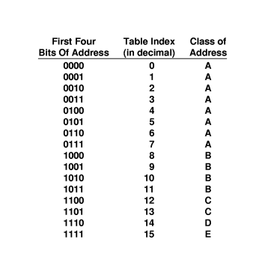

Slide 12
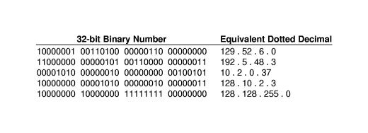
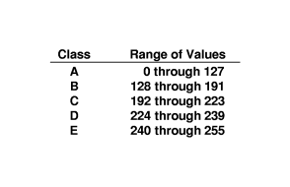
21.7 Classes and Dotted Decimal Notation 类别和点分十进制表示法

Slide 13
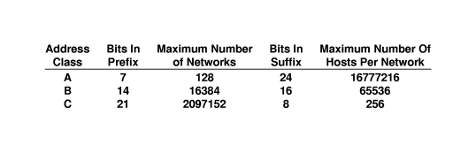
21.9 Division of the Address Space
地址空间的划分

Slide 14
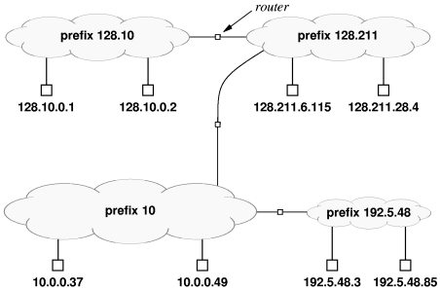
21.11 A Classful Addressing Example

Slide 15
21.12 Subnet and Classless Addressing
Address mask or subnet mask specify the boundary the network prefix and the suffix.
A==(D & M);
D: IP address;
M: subnet mask
CIDR notation: 128.10.0.0/16

Slide 16
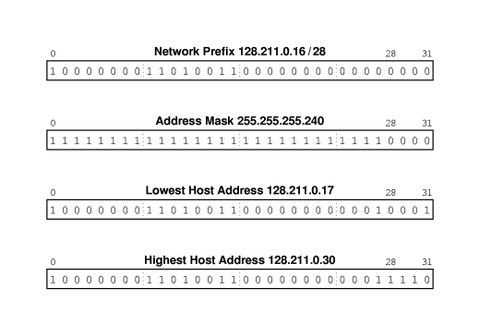
21.16 CIDR Host Addresses

Slide 17
21.17 Special IP Addresses
Network address(网络地址):
Directed Broadcast Address(直接广播地址).
Limited Broadcast Address(有限广播地址).
This Computer address(本机地址).
Loopback address(回送地址).

Slide 18
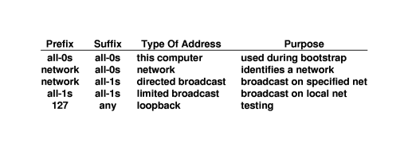
21.18 Summary of Special IP Addresses

Slide 19
21.20 Routers and the IP Addressing principle
An IP address does not identify a specific computer, Instead, each IP address identifies a connection between a computer and a network.
A computer with multiple network connections must be assigned one IP address for each connection.
A router has connections to multiple physical networks
Each router is assigned two or more IP addresses.

Slide 20
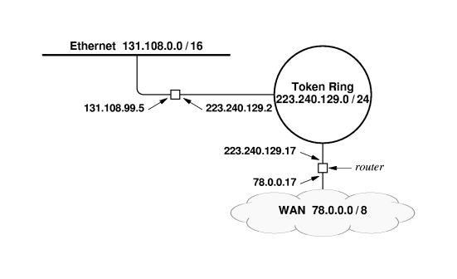

Slide 21
作业
已知IP地址
  218.193.48.48/27
  6.23.136.43/16
求
  地址类型
  网络位数、子网位数、主机位数
  子网掩码
  子网掩码支持的子网数量、一个子网内的主机数量

